Slide 1



SasView : A Small Angle Scattering Analysis Software Package
Andrew Jackson, European Spallation Source
on behalf of the SasView Collaboration

Slide 2
Analysis Software - Who’s Job is it Anyway?
Analysis is where the science is → the USER’S JOB
Scattering is a tool and part of providing the tool should be analysis tools → the FACILITY’S JOB
Data on disk is useless to EVERYBODY

Slide 3
Analysis Software - Who’s Job is it Anyway?
But … where are the resources?
More pressing tasks for all of us : maintaining & improving instrumentation, bringing in and supporting users, dealing with instrument control and data reduction software …
Data Analysis is bottom of the heap …
… need to pool resources.

Slide 4



A little history …
Where did SasView come from?
DANSE project output
~ 8.5% of funds were for SANS
Kickoff meeting August 2006
Heritage: NIST IGOR macros

Slide 5
Continuity …
NIST Supported initial transition from NSF funding

Slide 6
Expansion …
NIST Supported initial transition from NSF funding
Now 7 active facilities
ORNL, ISIS, NIST, ESS, ILL, TUD/RID, ANSTO
SINE2020 Funding at ESS
First major investment since DANSE
http://sine2020.eu

Slide 7
Development Model
Open, Collaborative, Community Development
Code is open source and publicly hosted at Github
Bug and Enhancement Ticket System - Trac
Bi-weekly developer calls
Code Camps
1st at NIST April 2013
2nd at ISIS April 2014
3rd at ESS Feb 2015
4th in Delft hosted by TU Delft / RID March 2016
5th at ORNL October 2016
5 Year Roadmap
http://www.sasview.org
http://github.com/SasView

Slide 8
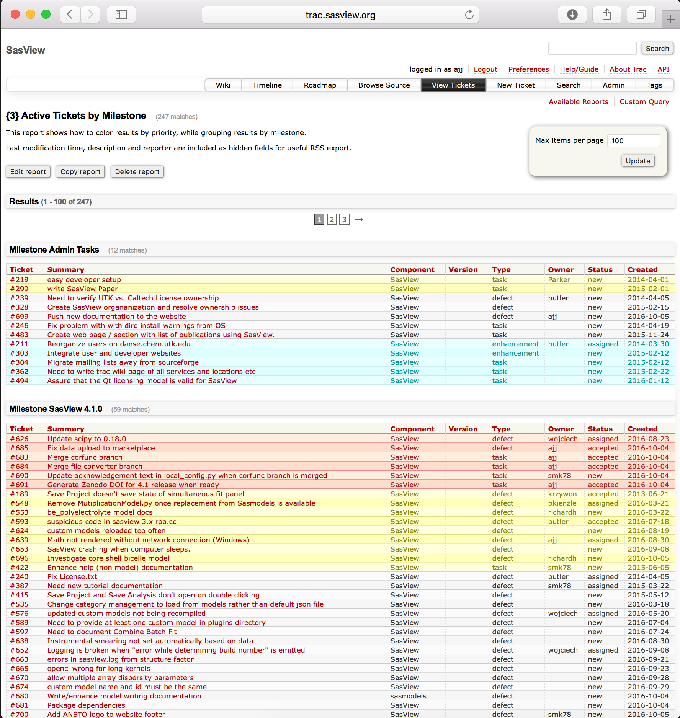
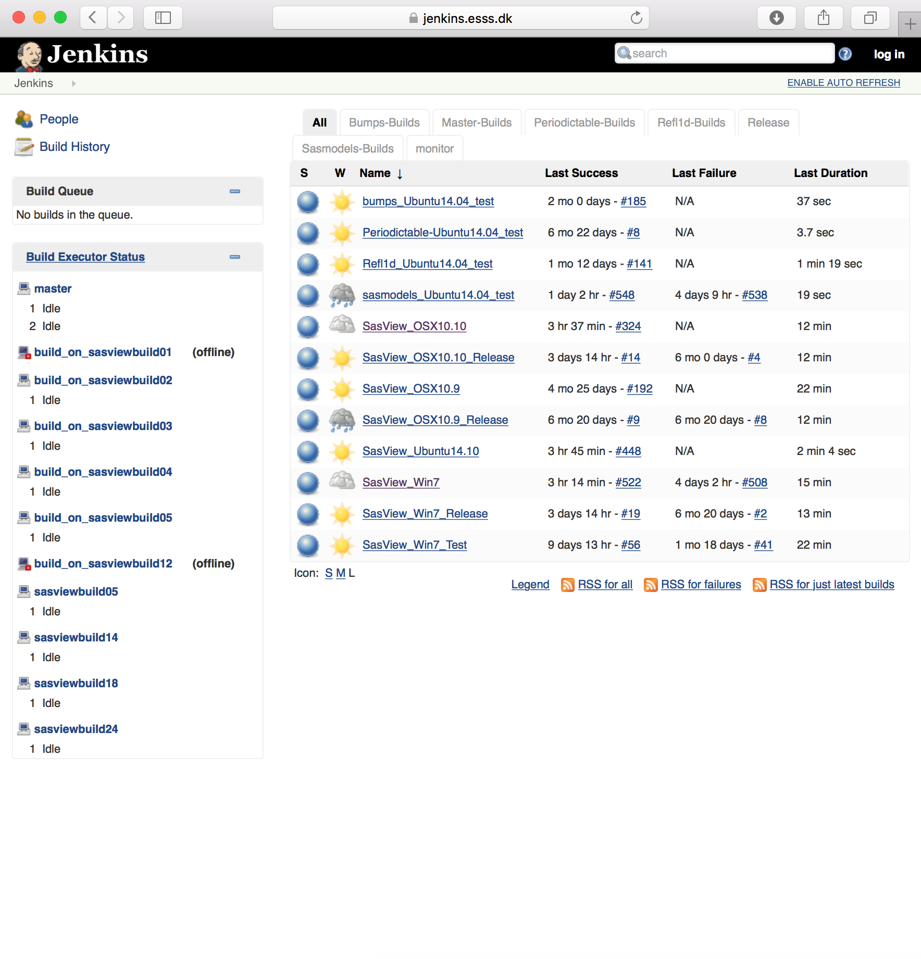
Development Model
www.sasview.org
Task and bug tracking – trac.sasview.org
Automated Builds
build.sasview.org
Hosted by UT
Hosted by ESS

Slide 9
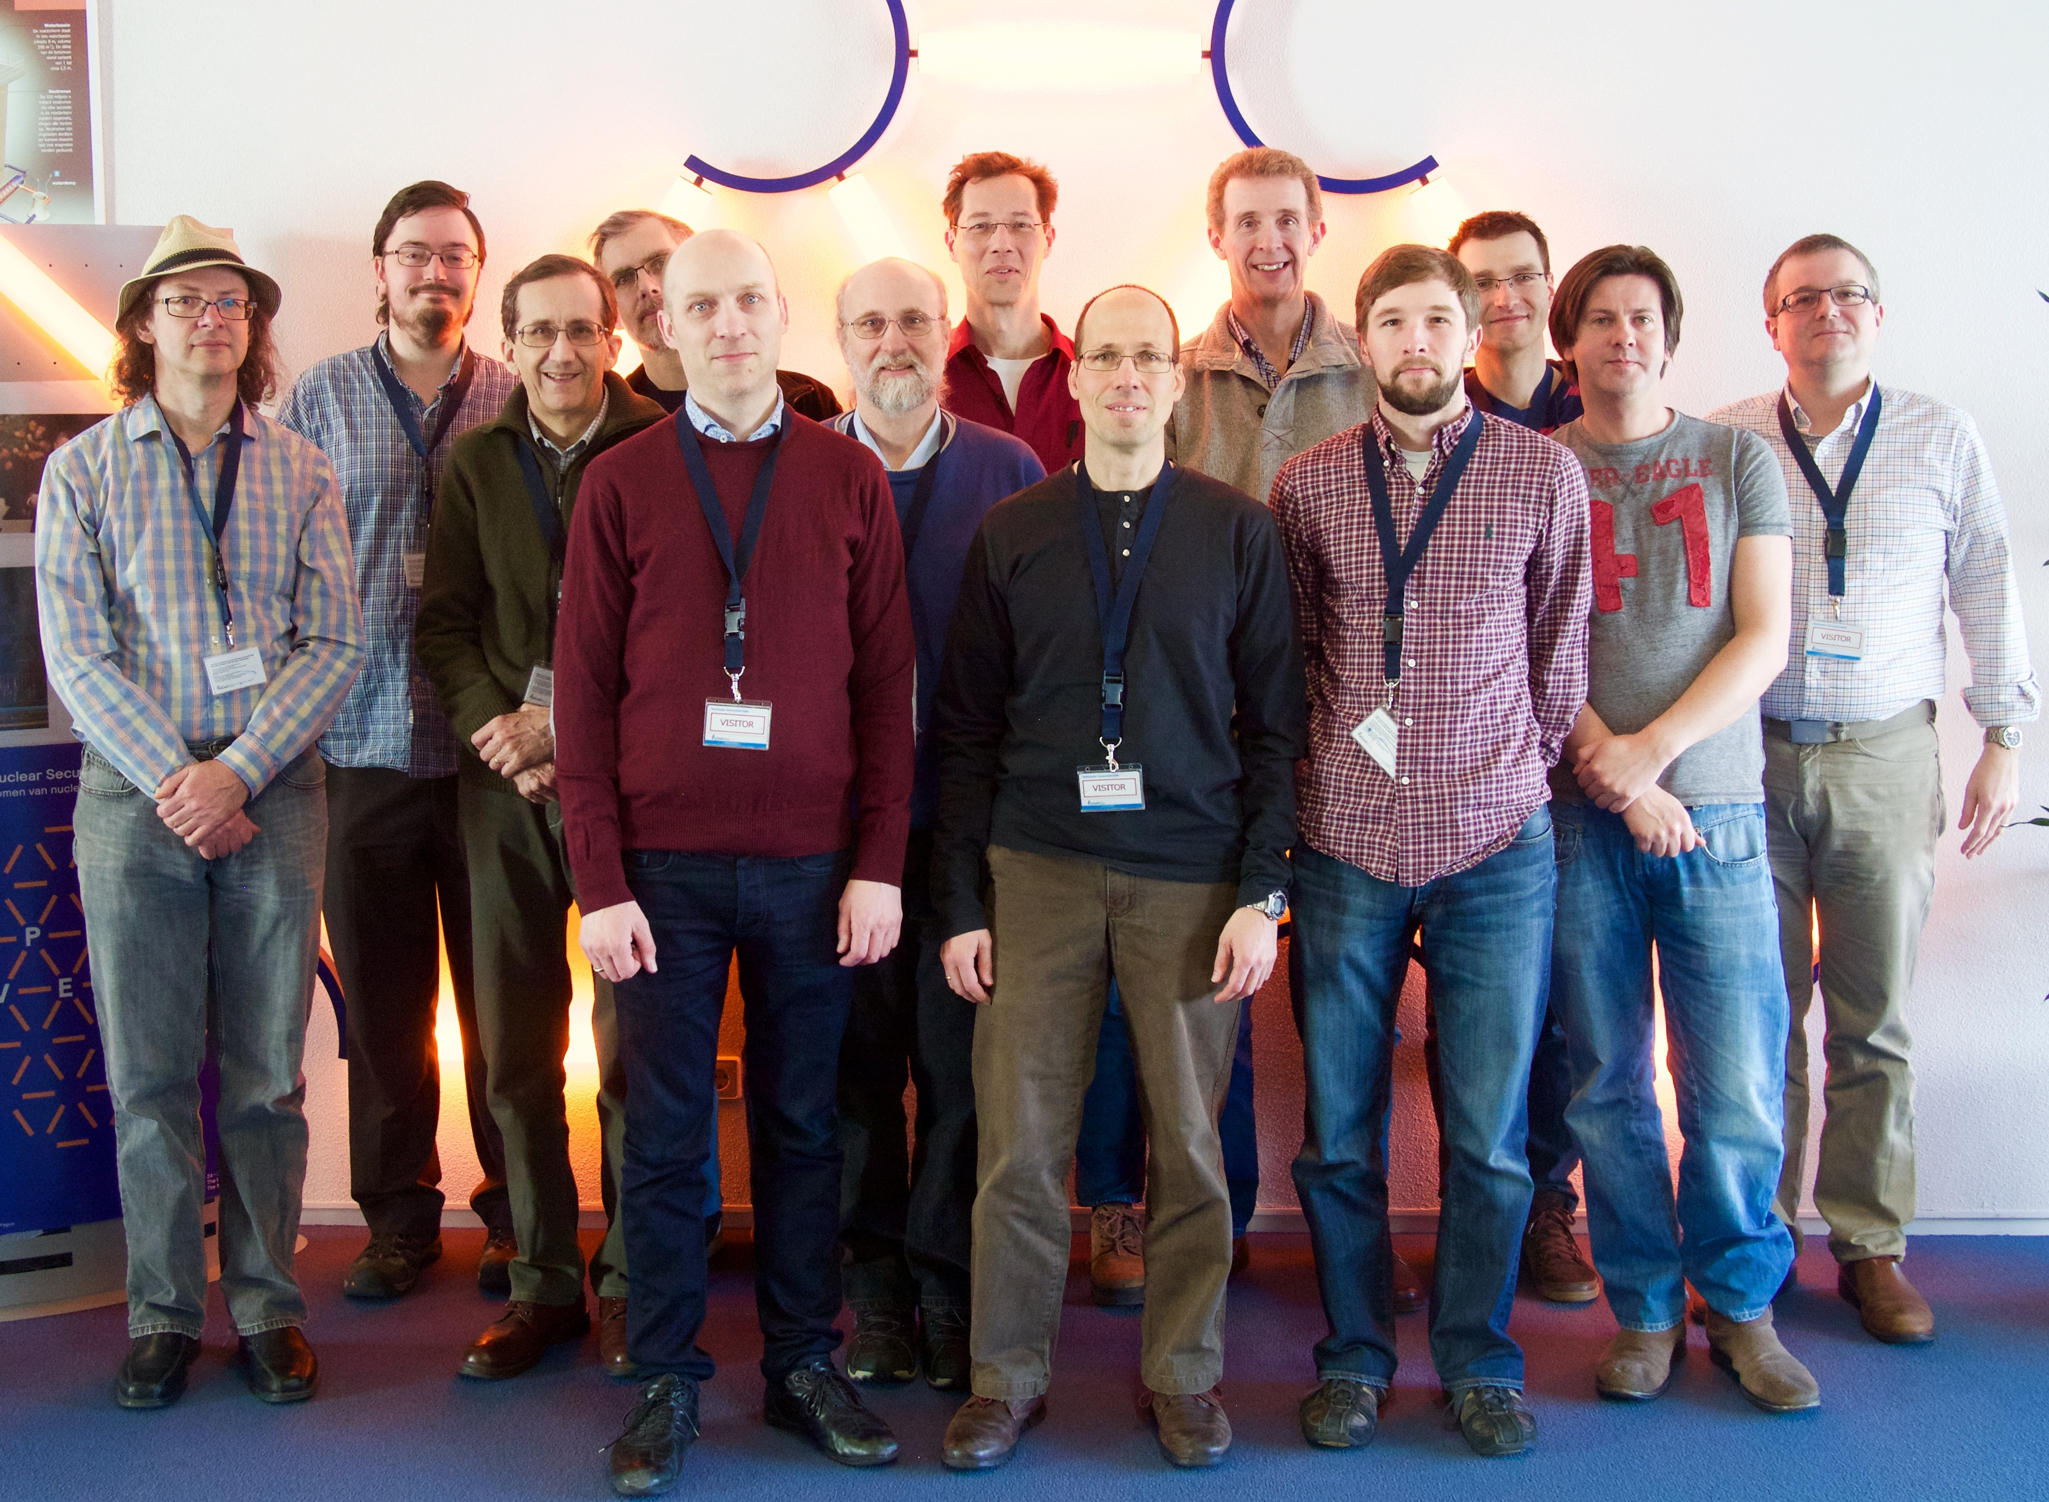
Current Development Team
Paul Butler (NIST)
Mathieu Doucet (ORNL)
Andrew Jackson (ESS)
Steve King (ISIS)
Jurrian Bakker (TUD)
Wim Bouwman (TUD)
Miguel Gonzales (ILL)
Richard Heenan (ISIS)
Dirk Honecker (ILL)
Paul Kienzle (NIST)
Jeff Kryzwon (NIST)
Ricardo Leal (ORNL)
David Mannicke (ANSTO)
Torben Nielsen (ESS)
Lewis O’Driscoll (ISIS)
Steve Parnell (TUD)
Wojciech Potrzebowski (ESS)
Piotr Rozyczko (ESS)
Adam Washington (Sheffield)
and thanks to the many previous contributors, particularly Jae Hie Cho and Alina Gervaise

Slide 10
What Can SasView Do Currently?

Slide 11
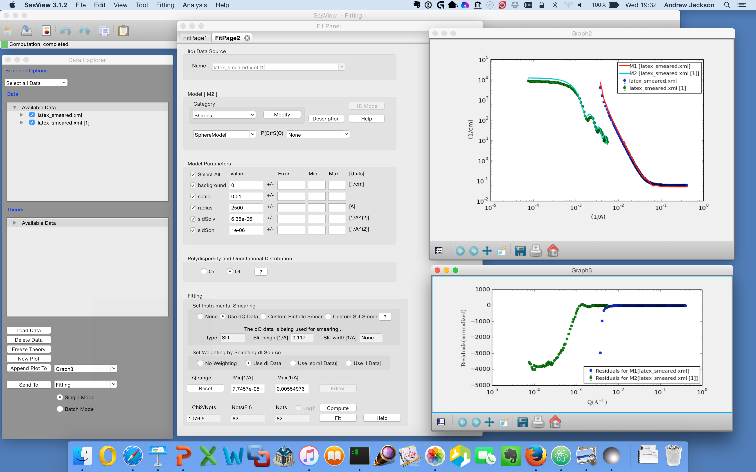
1D Analysis

Slide 12
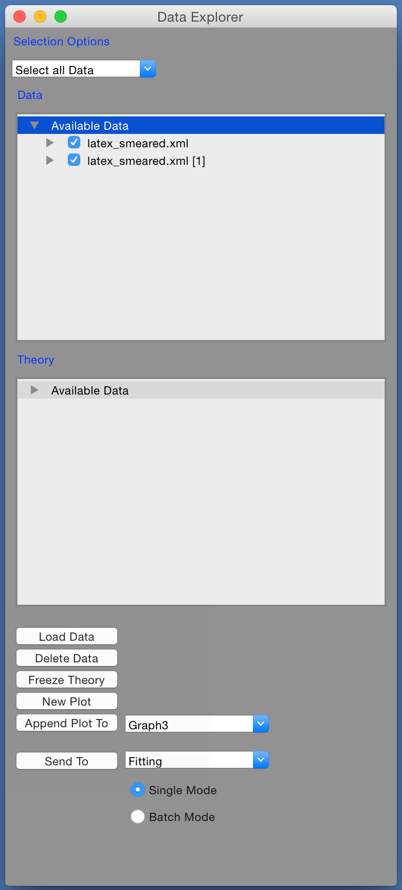
1D Analysis
Load Data …
Select Data Sets …
Here we have SANS & USANS from latex spheres
Send to Fitting …

Slide 13
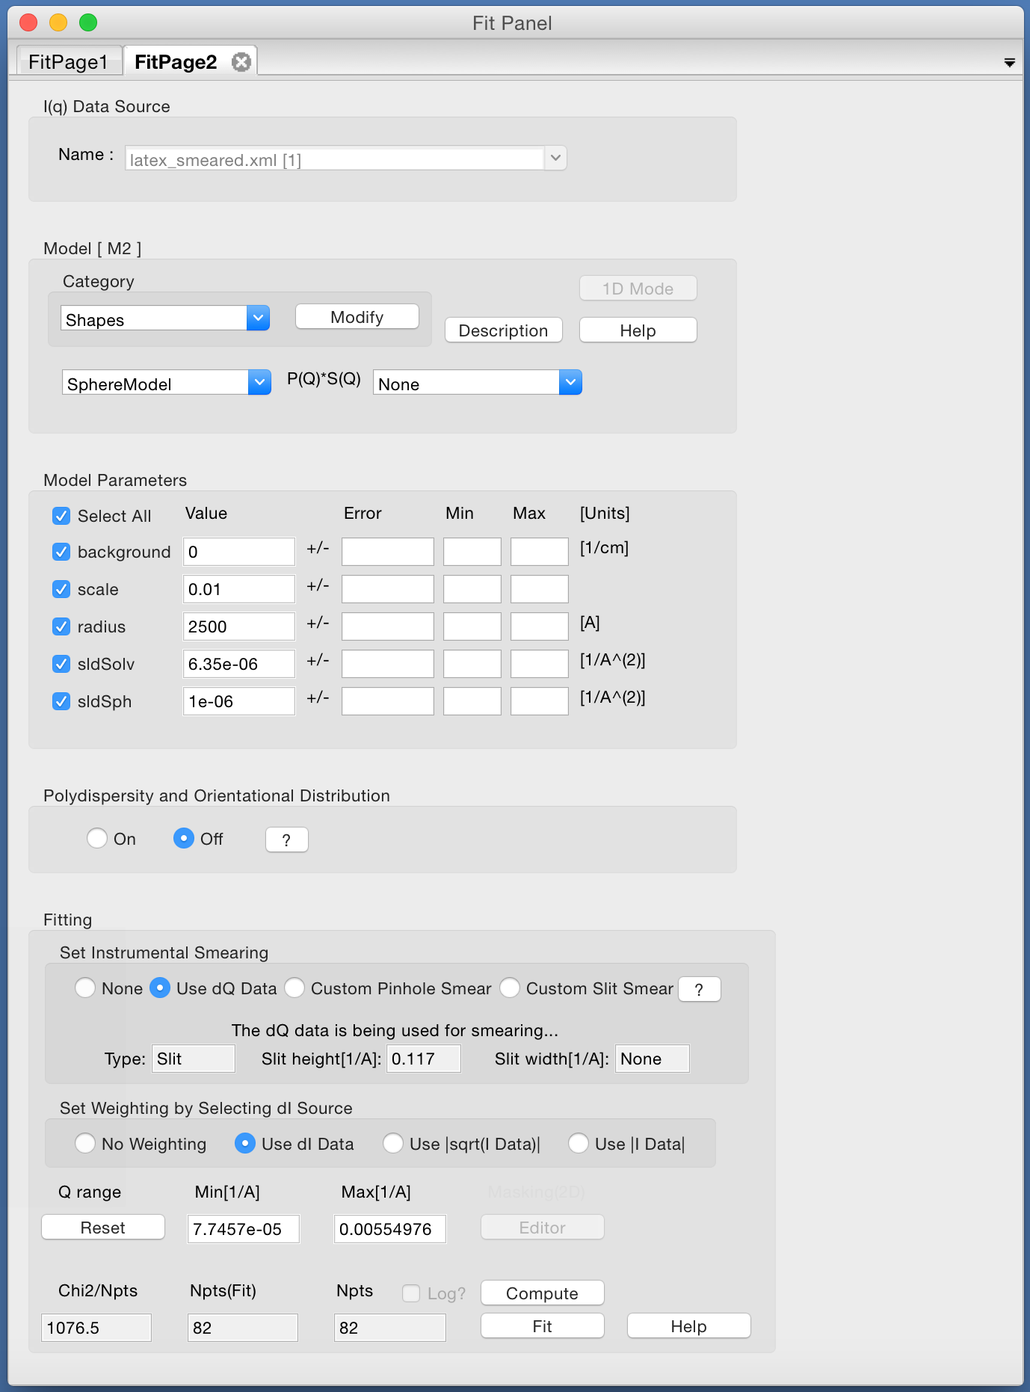
1D Analysis
Send to fitting …
Select a model …

Slide 14
1D Analysis
Send to fitting …
Select a model …
Set parameters …

Slide 15
1D Analysis
Send to fitting …
Select a model …
Set parameters …
Use resolution …

Slide 16
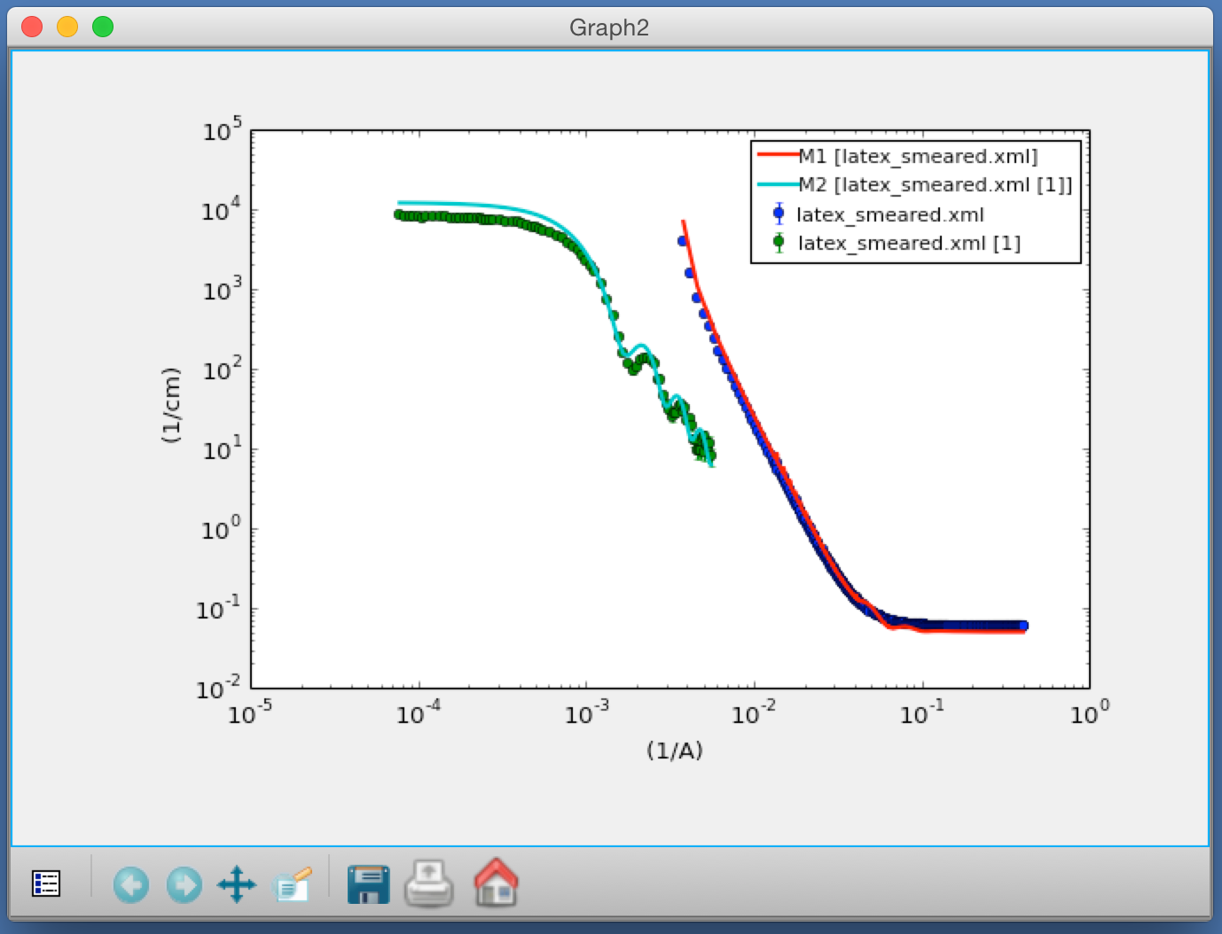
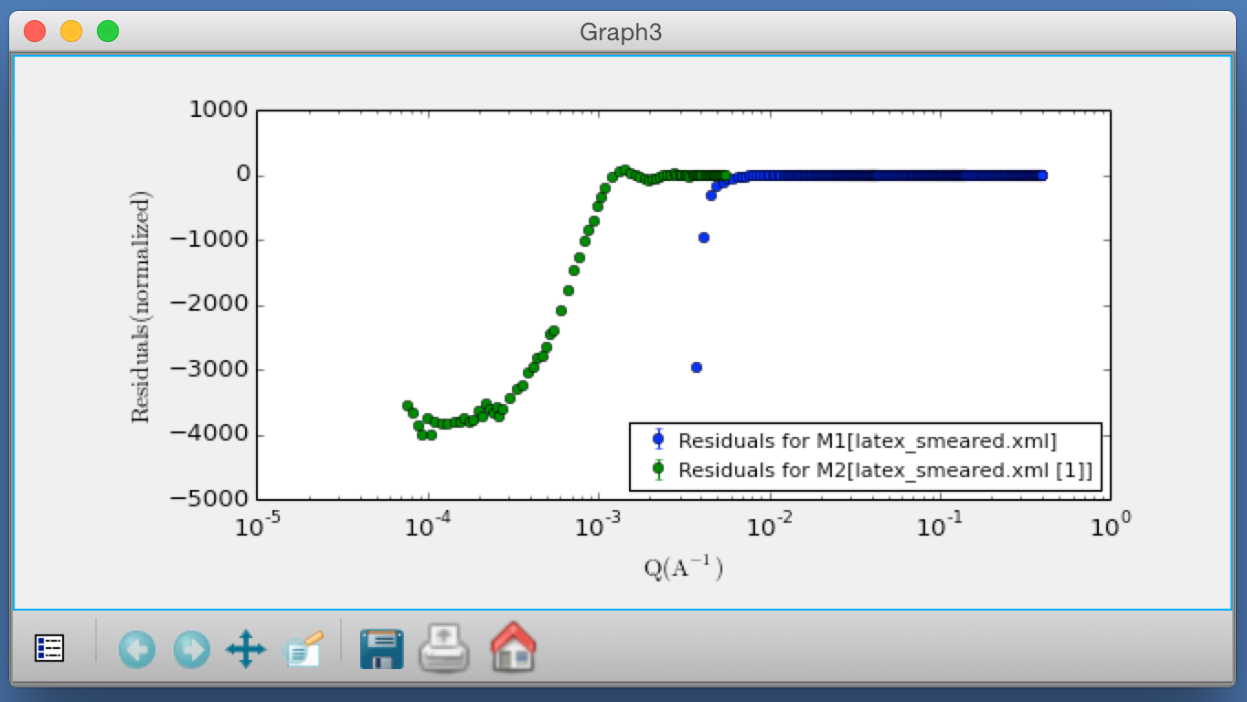
1D Analysis
Send to fitting …
Select a model …
Set parameters …
Use resolution …
How does it look?

Slide 17
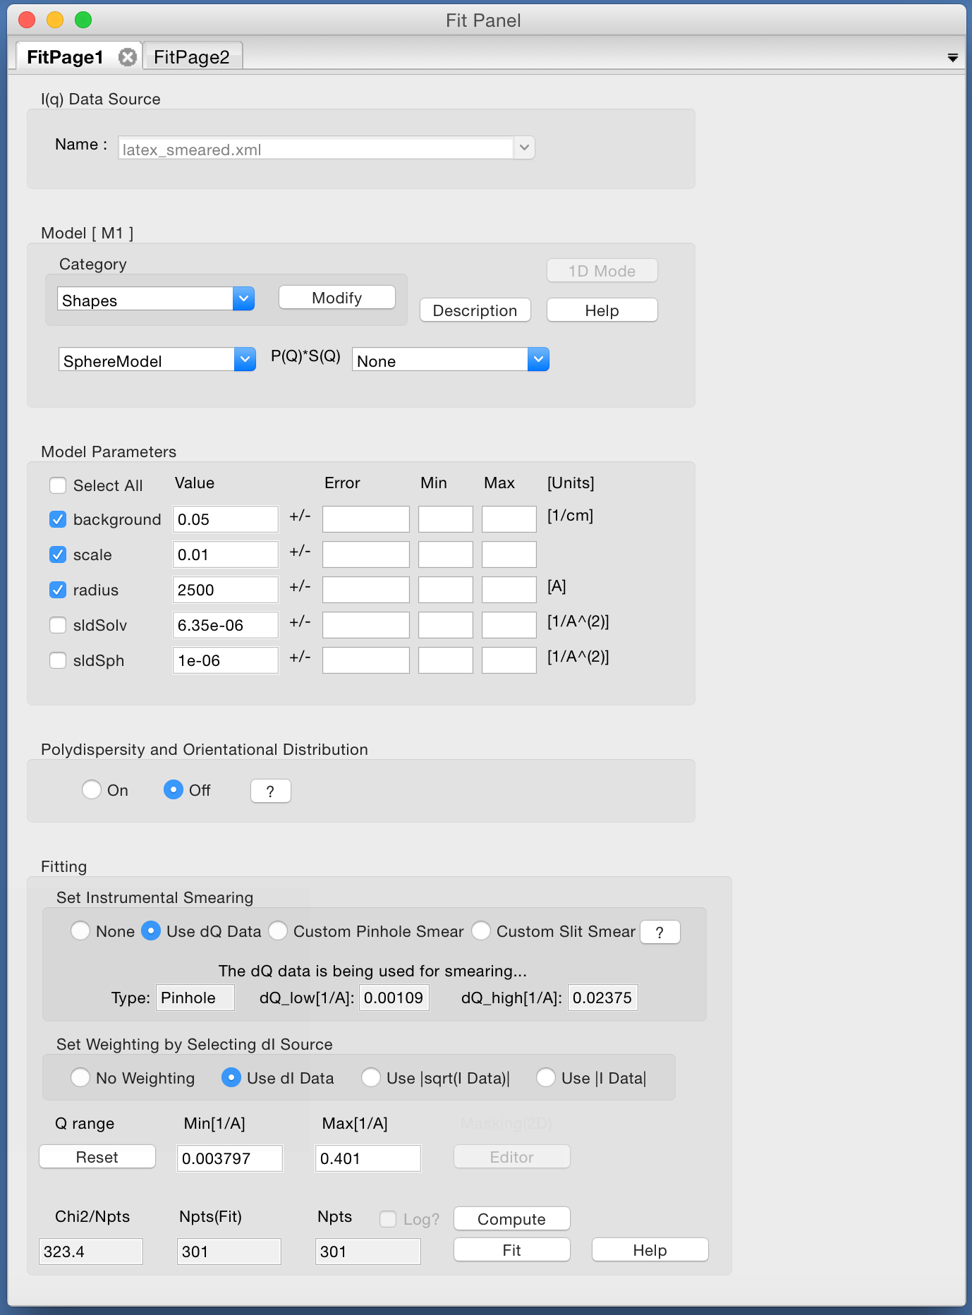
1D Analysis
Choose which parameters to fit …

Slide 18
1D Analysis
Choose which parameters to fit …
… and press the Fit button!

Slide 19
Constraints / Simultaneous Fit
But wait! We have two data sets of the same sample : SANS + USANS …

Slide 20
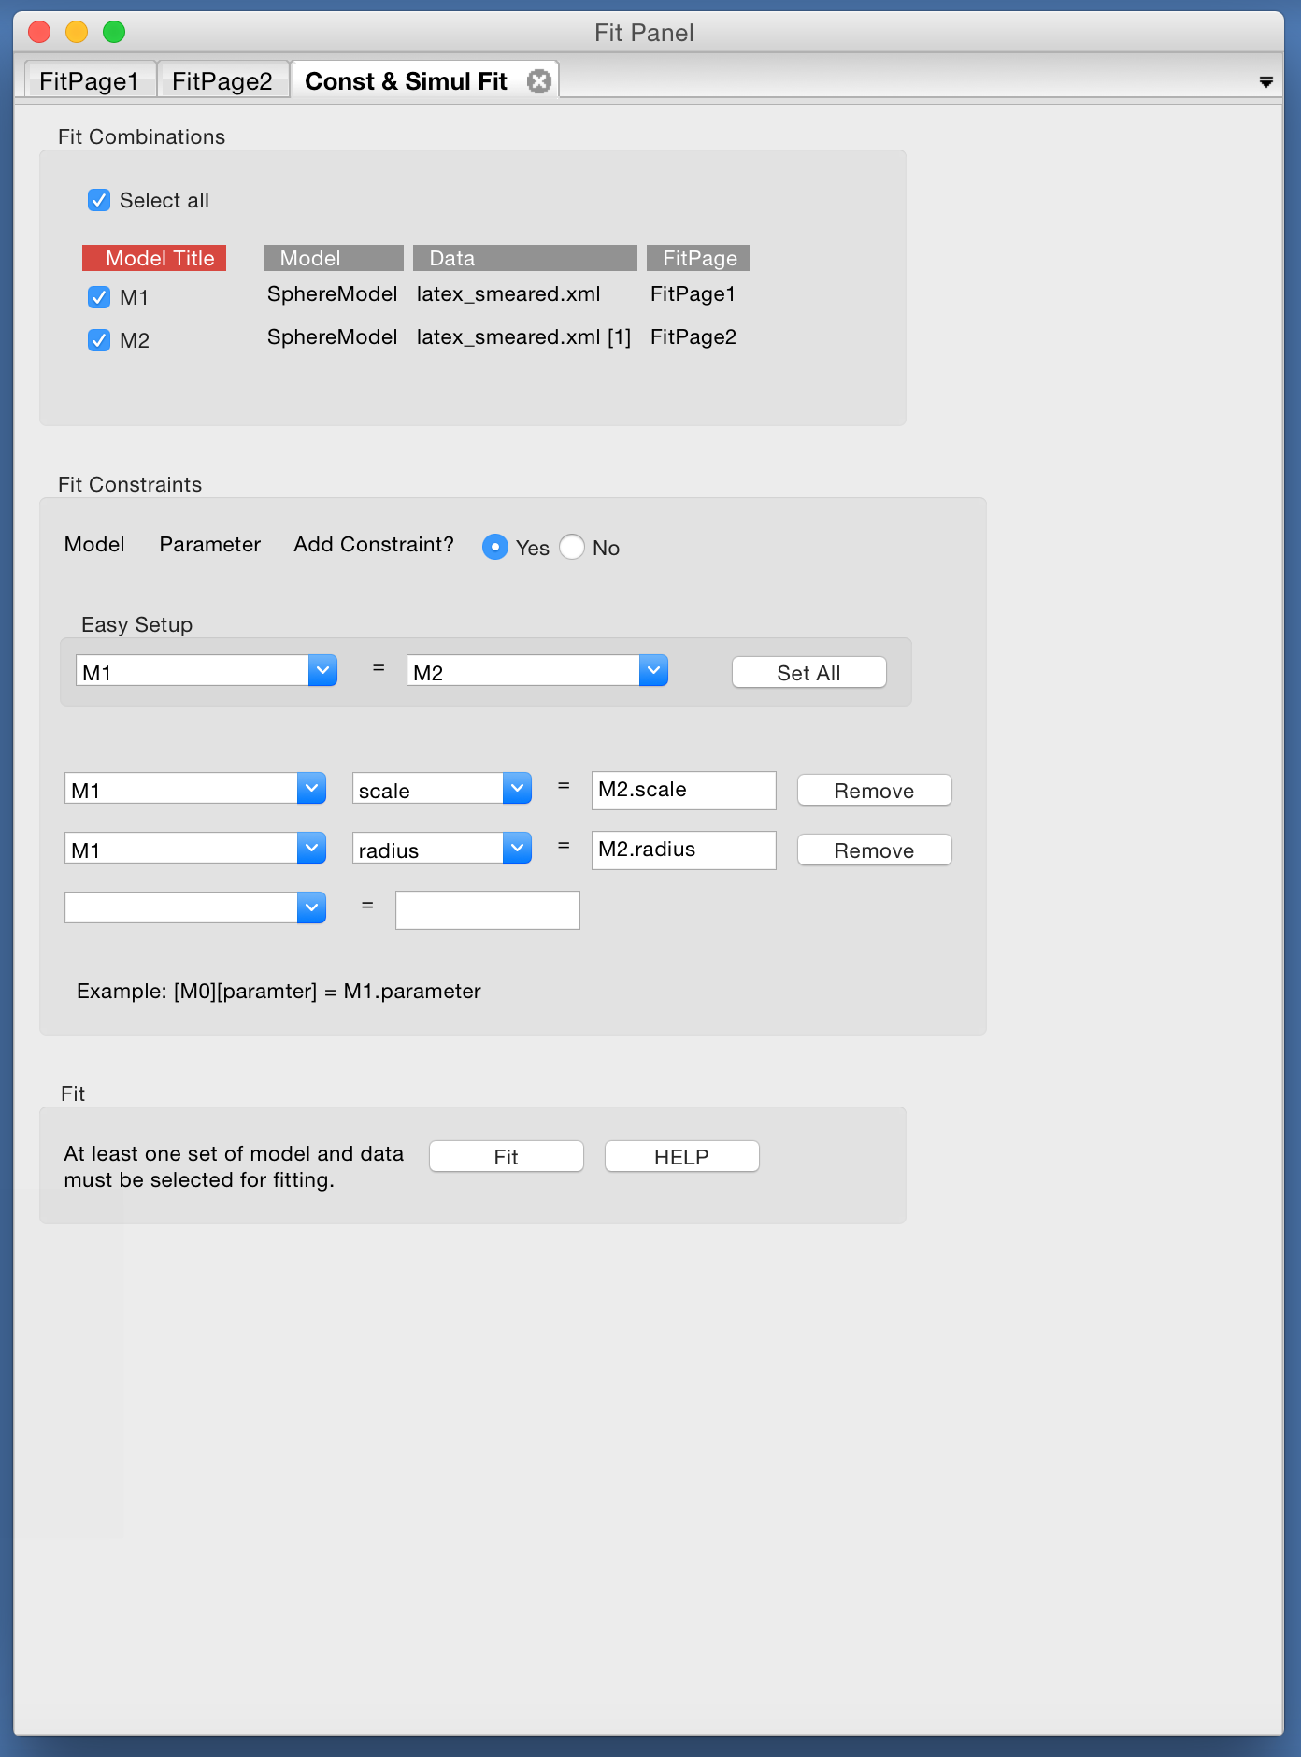
Constraints / Simultaneous Fit
But wait! We have two data sets of the same sample : SANS + USANS …
Set up a simultaneous fit …

Slide 21
Constraints / Simultaneous Fit
But wait! We have two data sets of the same sample : SANS + USANS …
Set up a simultaneous fit …
… with constraints

Slide 22
Constraints / Simultaneous Fit
But wait! We have two data sets of the same sample : SANS + USANS …
Set up a simultaneous fit …
… with constraints
Now press the Fit button!

Slide 23
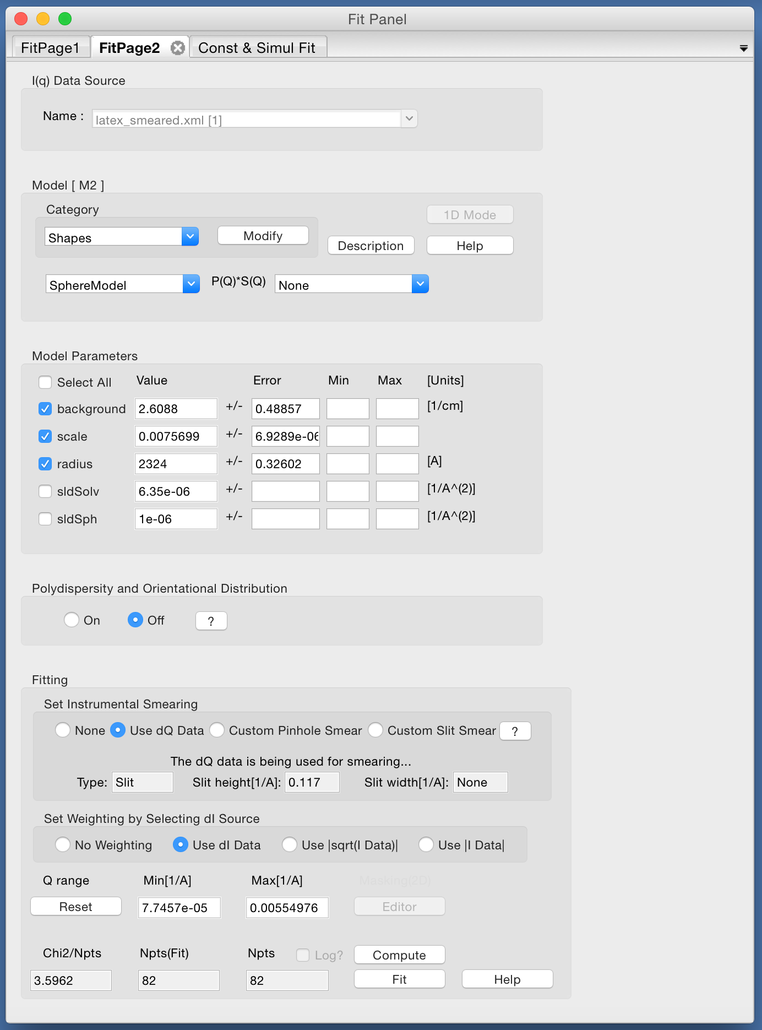
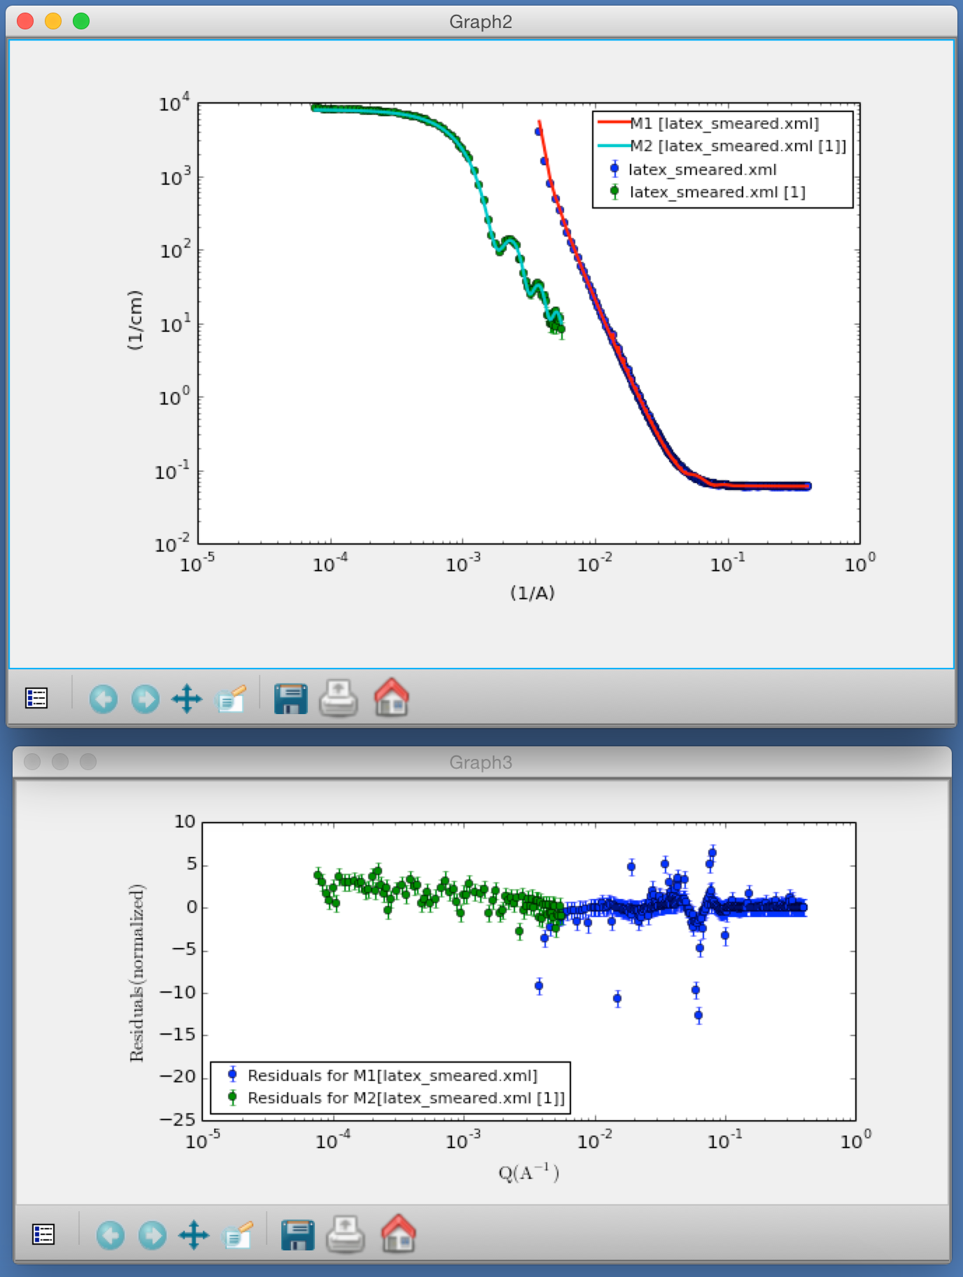
Constraints / Simultaneous Fit

Slide 24
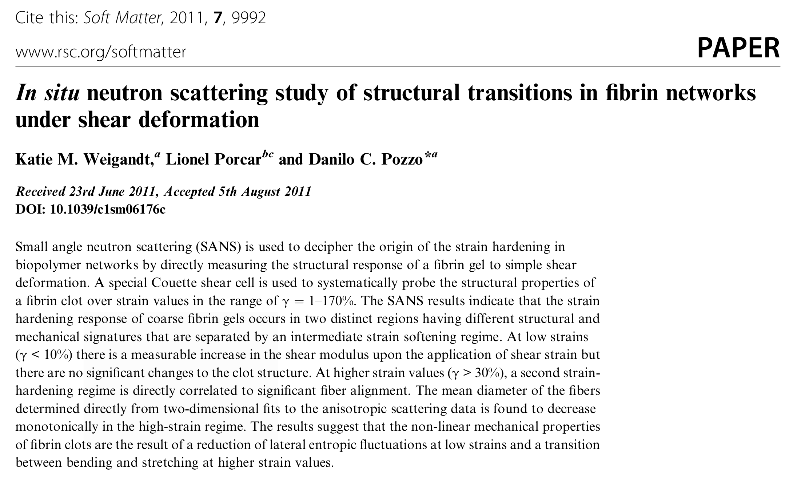
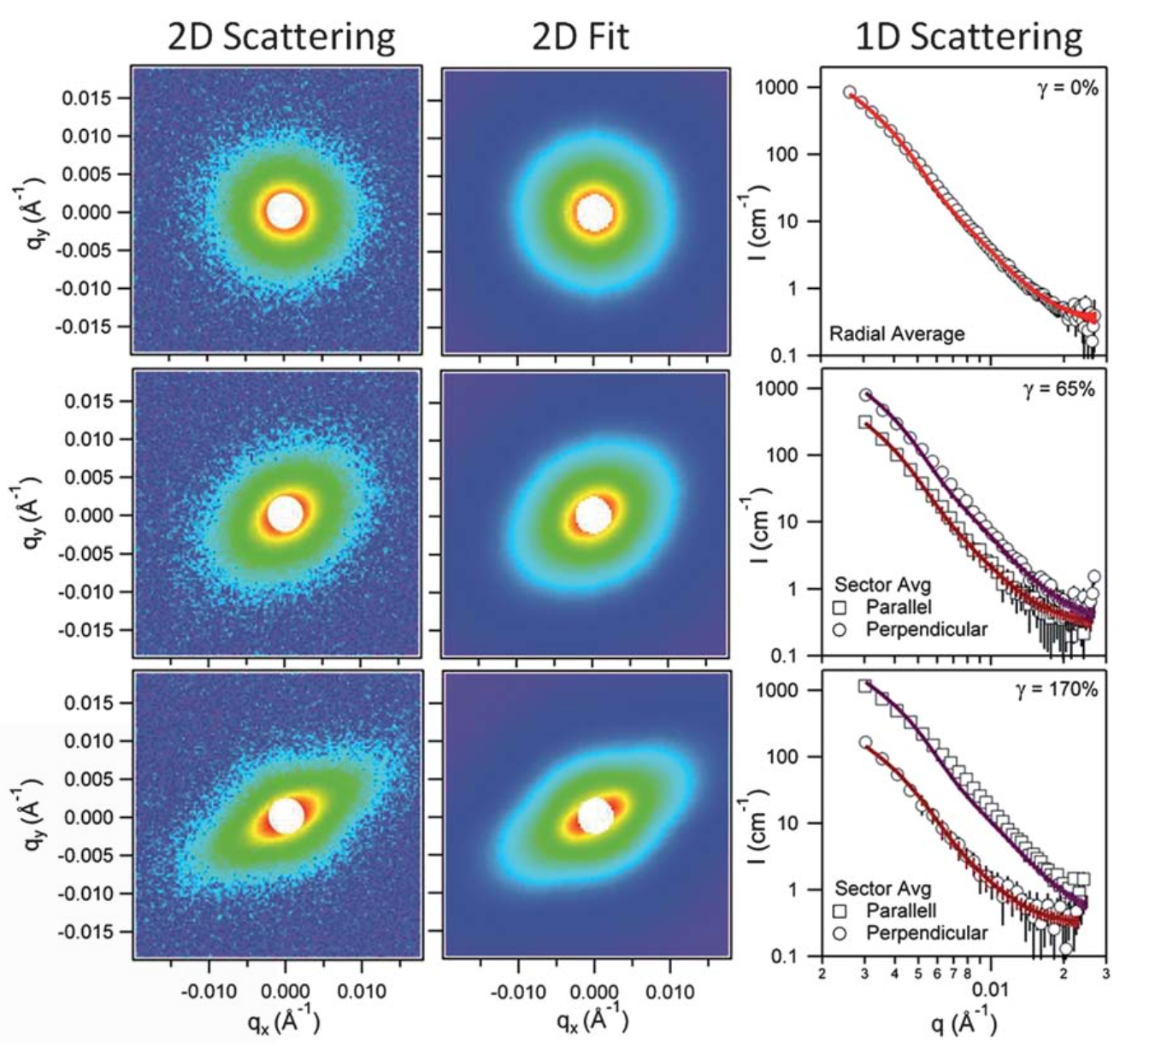
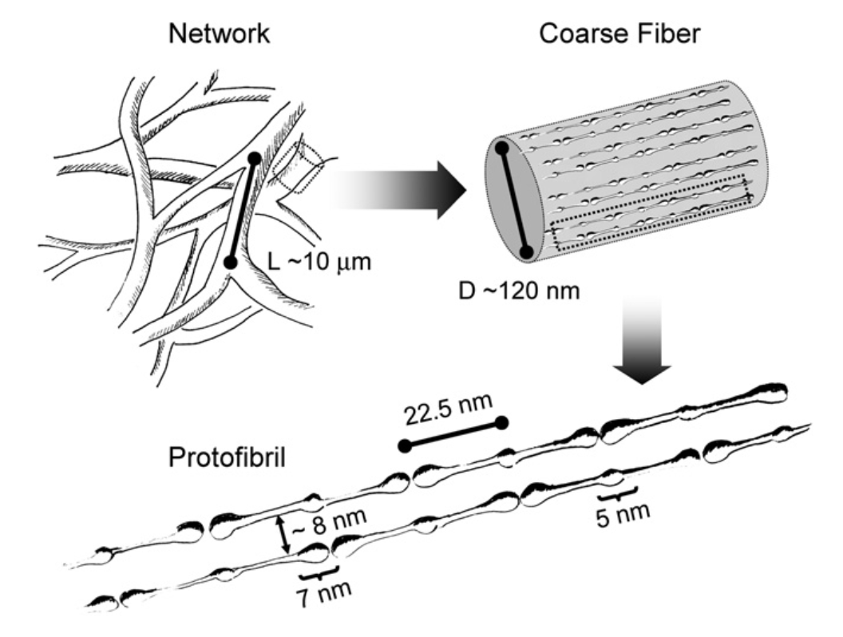
2D Modelling

Slide 25
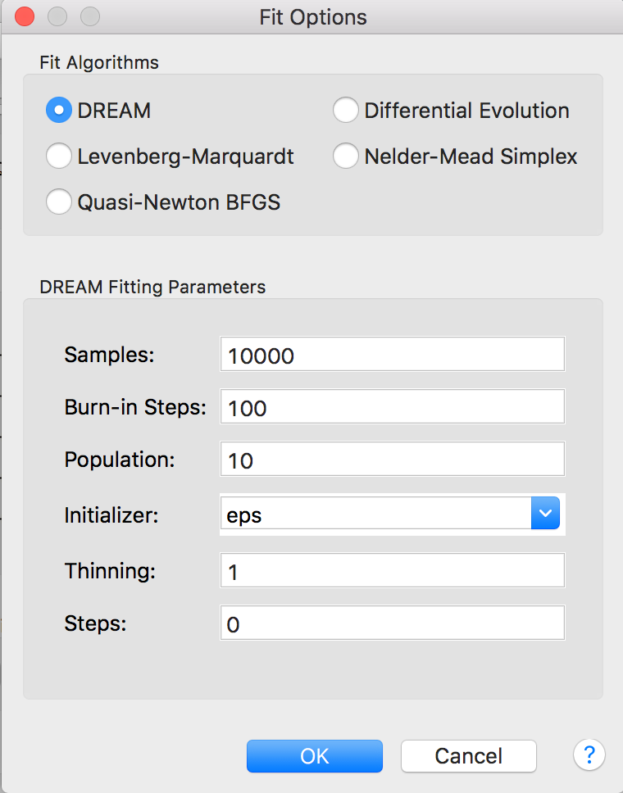
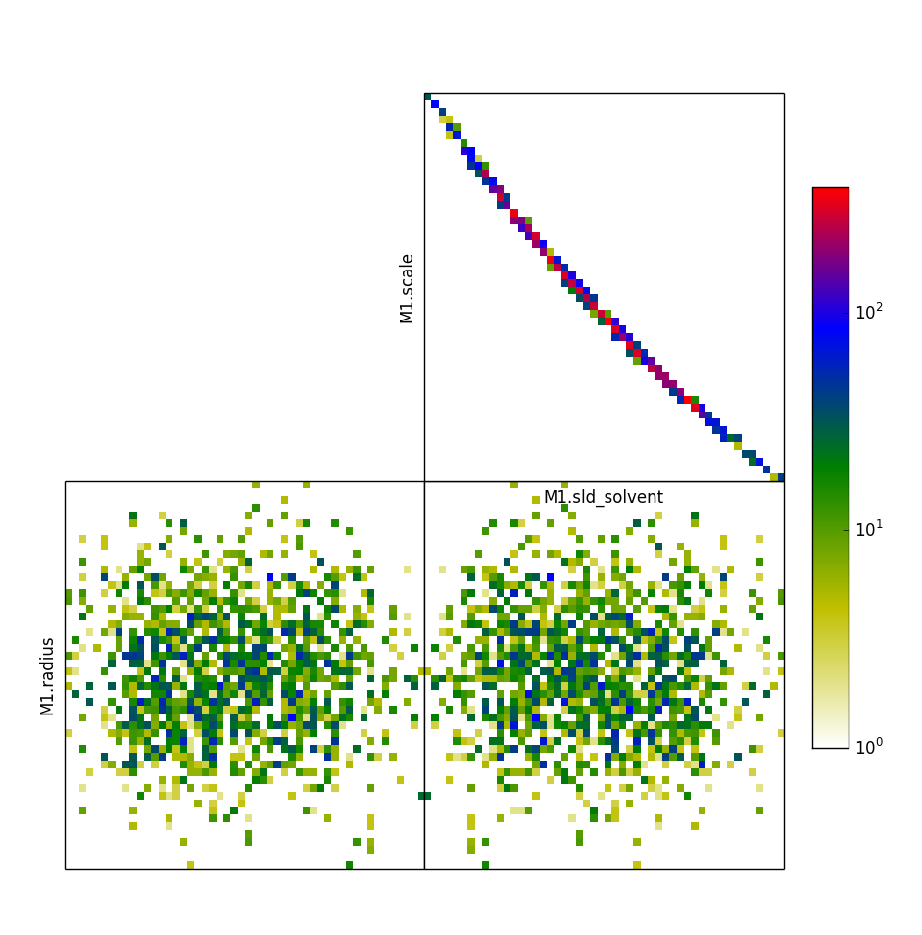
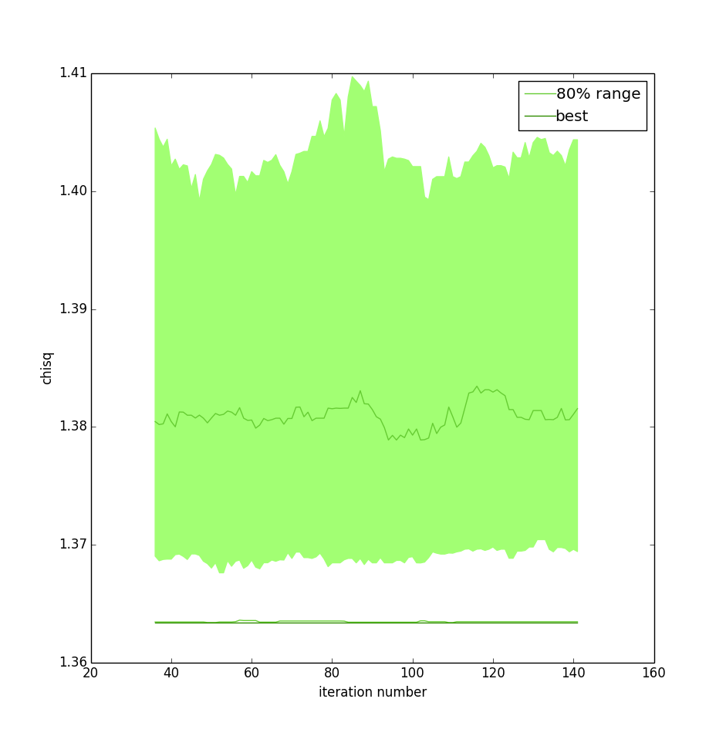
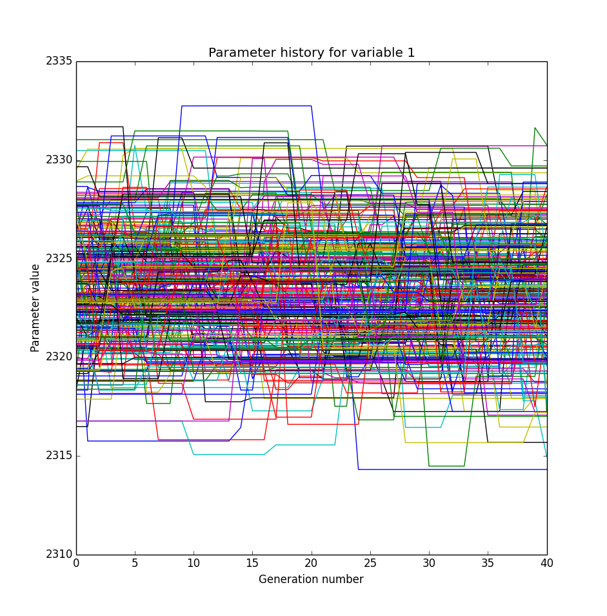
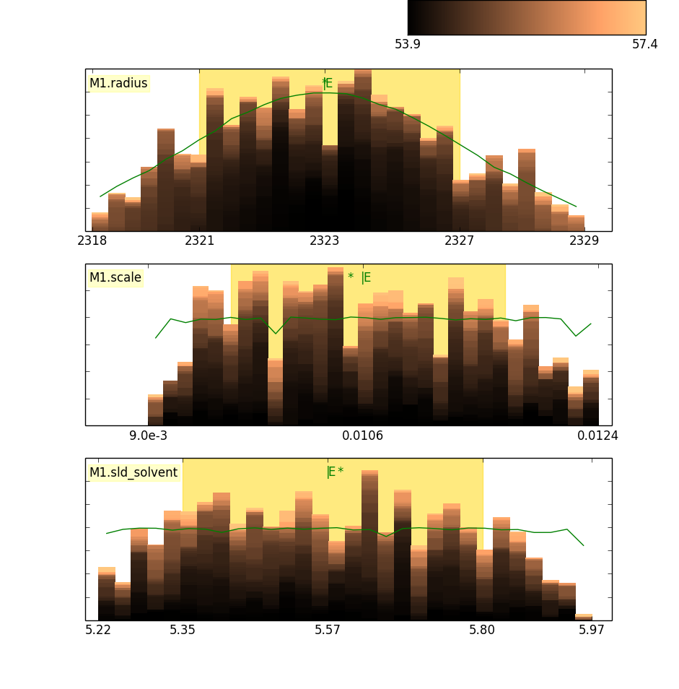
Fitting Algorithms

Slide 26
Fitting Algorithms

Slide 27
Fitting Algorithms

Slide 28
Fitting Algorithms

Slide 29
Fitting Algorithms

Slide 30
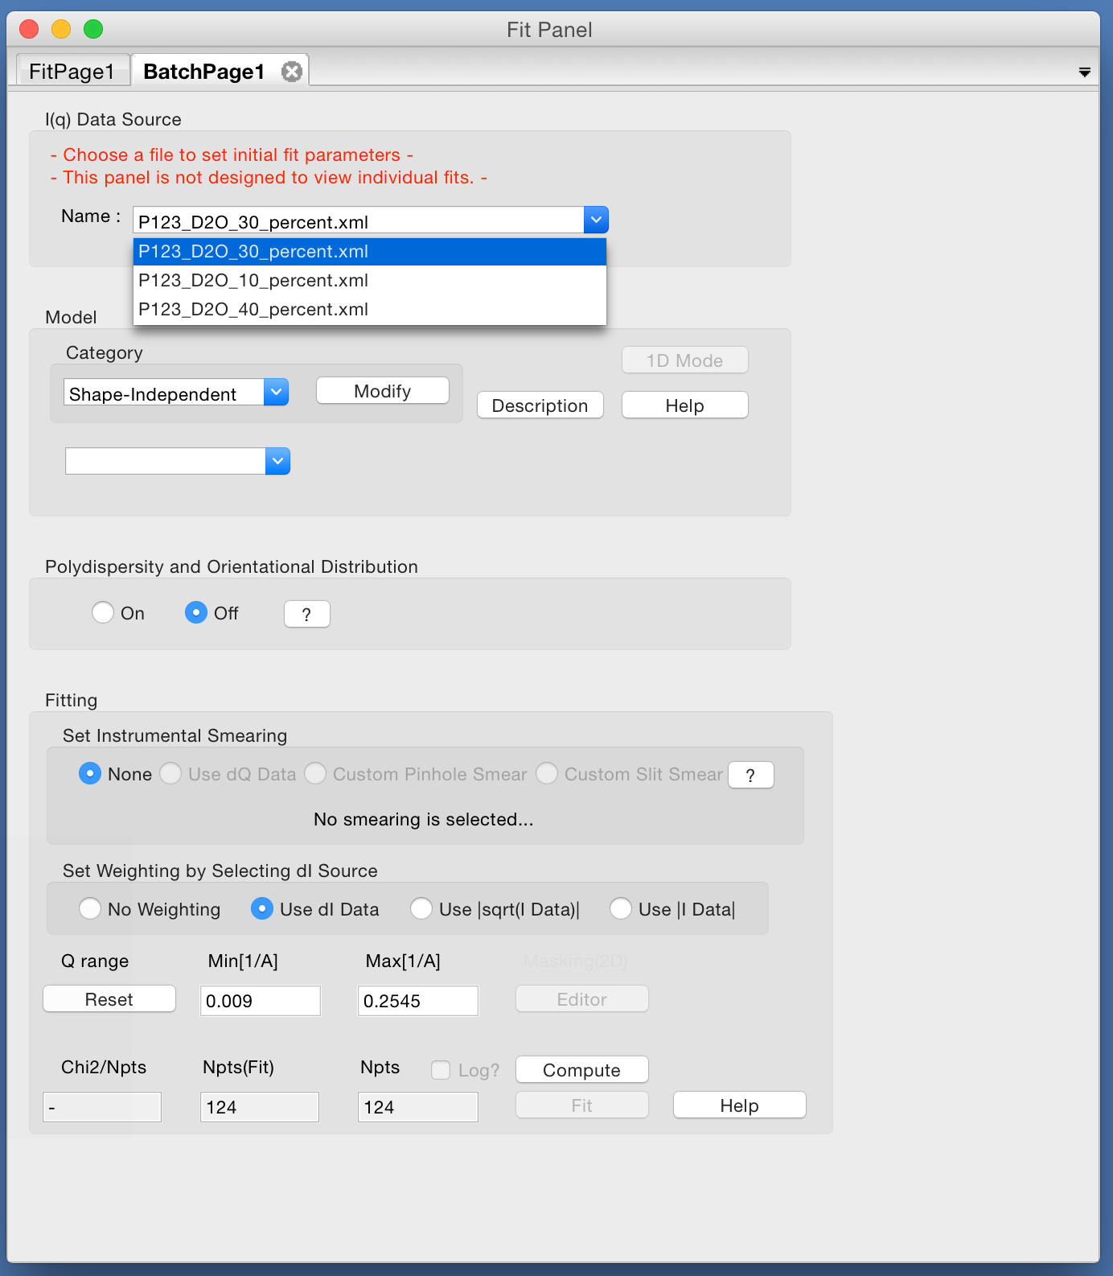
Other Features
Batch fitting …

Slide 31
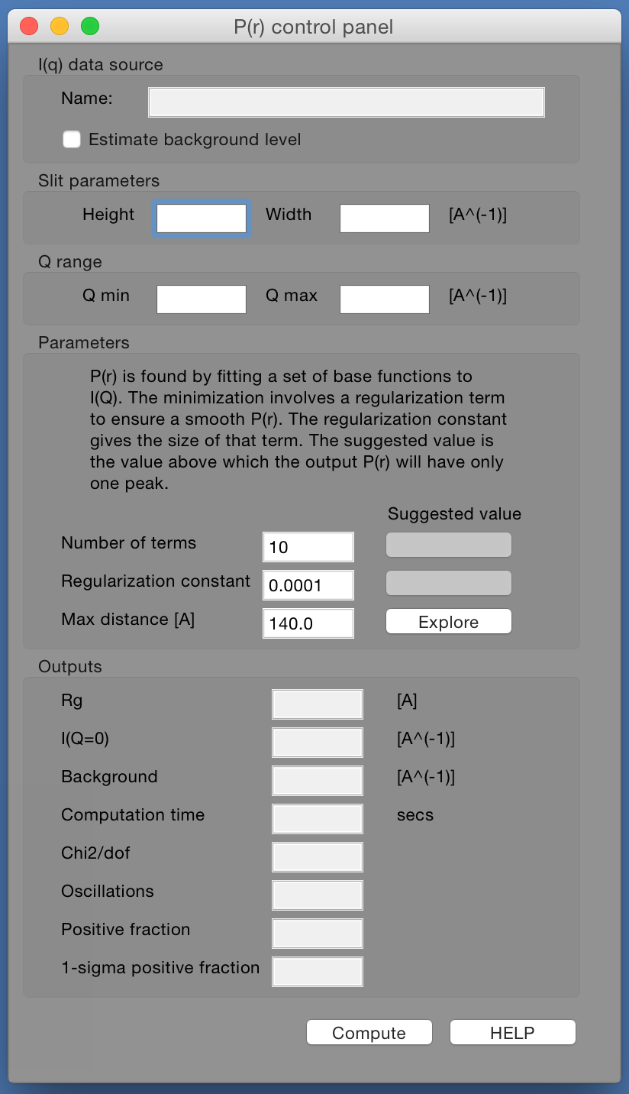
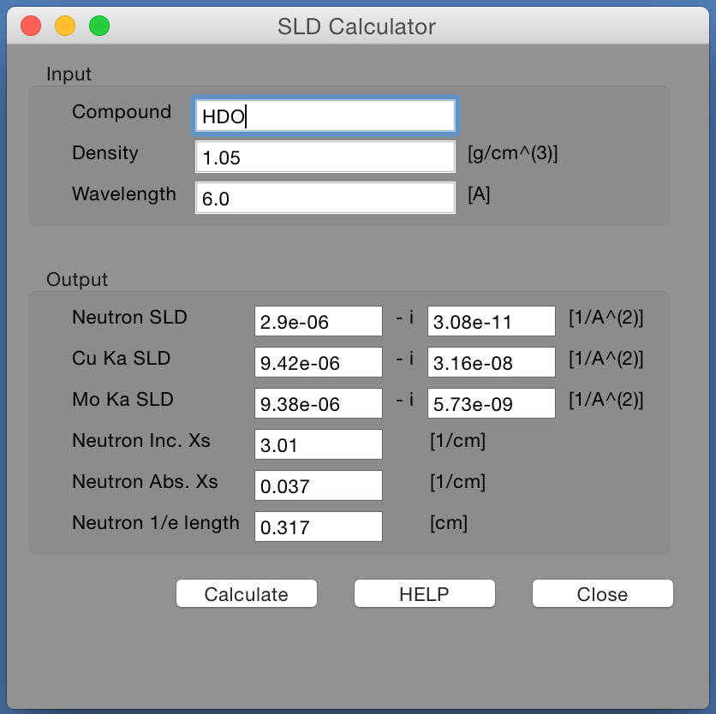
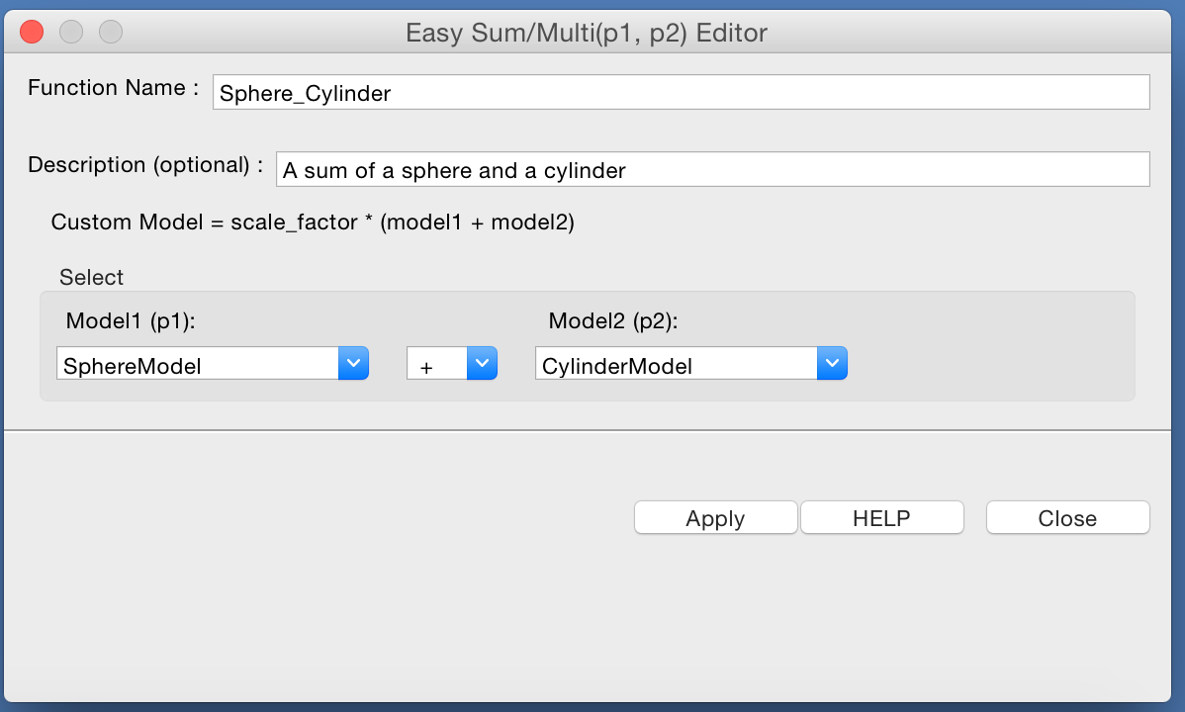
Other Features
SLD Calculator …
P(r) Inversion …
Sum & Multiplication of Models …

Slide 32
Creating Models
Old Way
Write a model in python and drop it in plugin folder
Easy but no polydispersity available
Write a model in C and incorporate into SasView
Difficult and need to recompile whole programme
New Way
Models distributed in separate package (sasmodels)
separation of models from GUI
simpler addition of models by users
speed! GPU and parallel processing
All models work the same
Write in python and/or C and drop in plugin folder

Slide 33
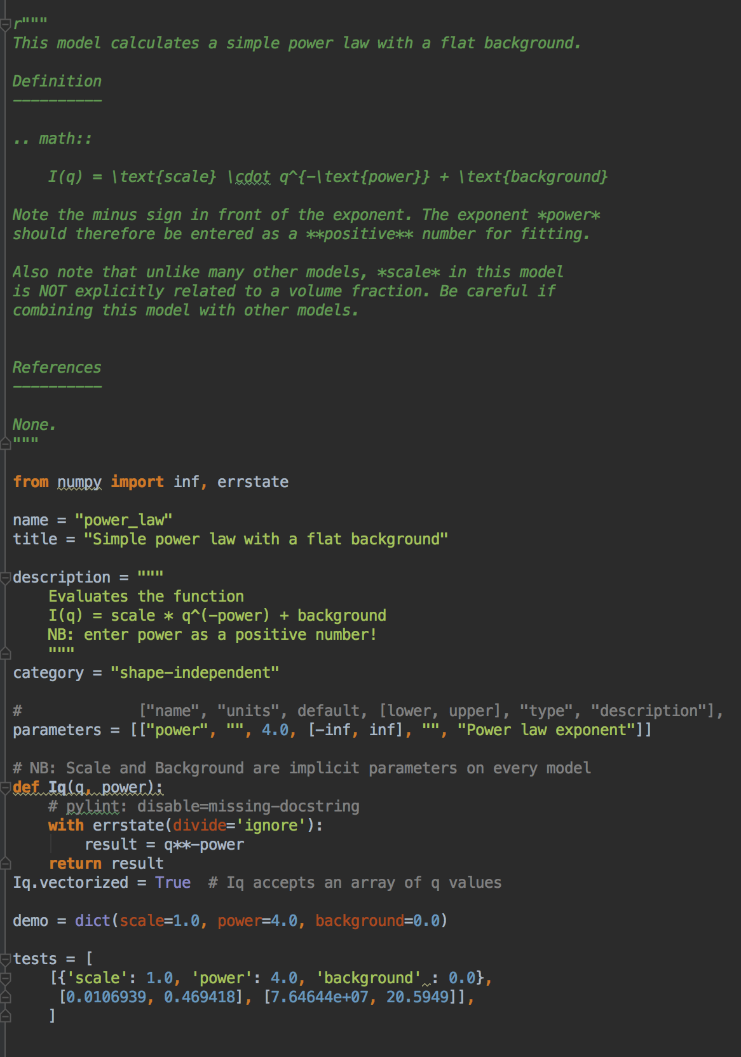
Creating Models
Pure Python
Documentation
Description
Parameters
Calculation
Tests

Slide 34
SasView 4.0 is Out!
www.sasview.org
Models
New models
New model package (sasmodels)
Separation of models from GUI
Simpler addition of models by users
Speed! GPU and parallel processing
Documentation
Enhanced, updated documentation for models
SESANS in sasmodels
Automatic transform of SANS model to P(z)
Example scripts for fitting SESANS data
Simultaneous fitting of SANS & SESANS

Slide 35
Future …
GUI Refactoring
Move to QT - current and well supported toolkit
Complete separation of GUI and calculation code
Non-desktop UIs
Sasmodels Enhancements
Return F(q) from models
Beta approximation
Coherent sums
Multi-GPU support
Documentation
Tutorials
Manual

Slide 36
Future …
And much more!
See Roadmap and Tickets
Contributions Needed
All skill sets welcome
Models
Testing
Documentation
Admin and Infrastructure
Questions?

